Slide 1


Introduction to Modelling of Cyber-Physical Systems (CPSs)
Peter Gorm Larsen, Aarhus University
together with
Casper Thule, Aarhus University
Ken Pierce, Carl Gamble, John Fitzgerald,
Newcastle University
Claudio Gomes, Antwerp University

Slide 2
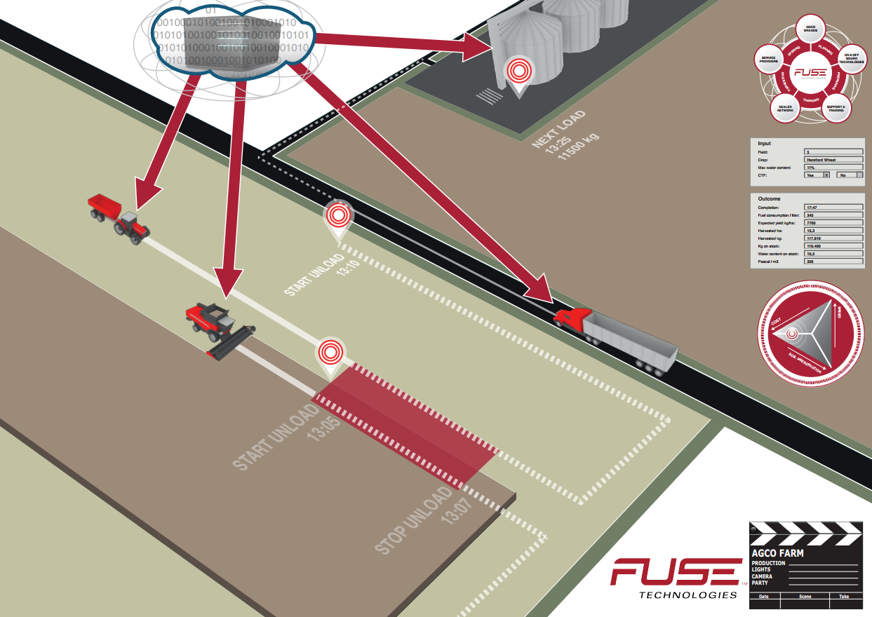
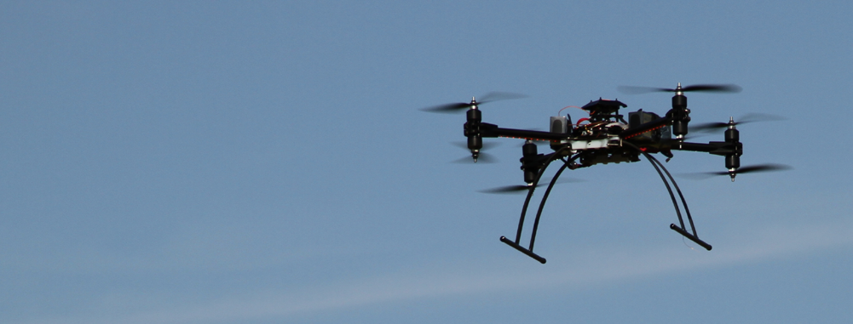
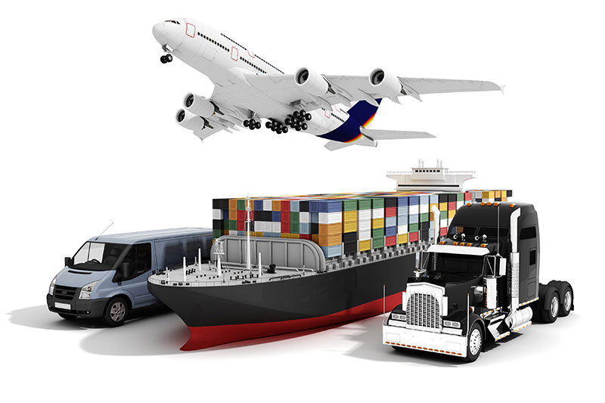
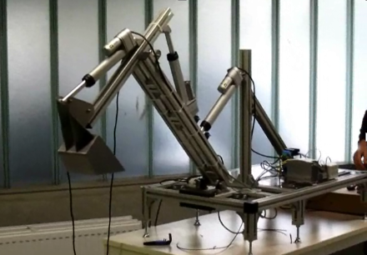
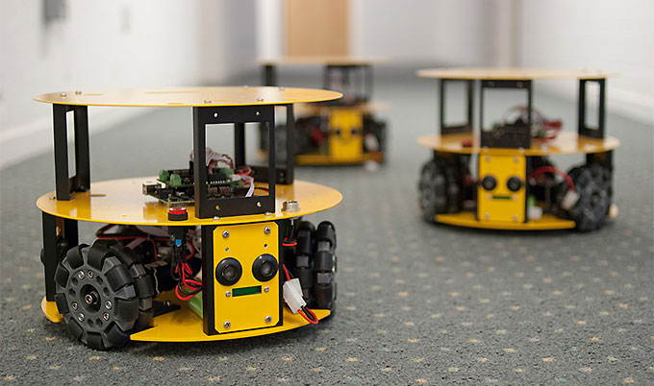
What is a Cyber-Physical System?
Systems of interacting systems
Computing elements
Physical elements
Human interactions
Complex, networked character
Distributed control
Error detection and recovery

Slide 3
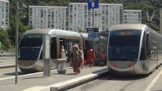
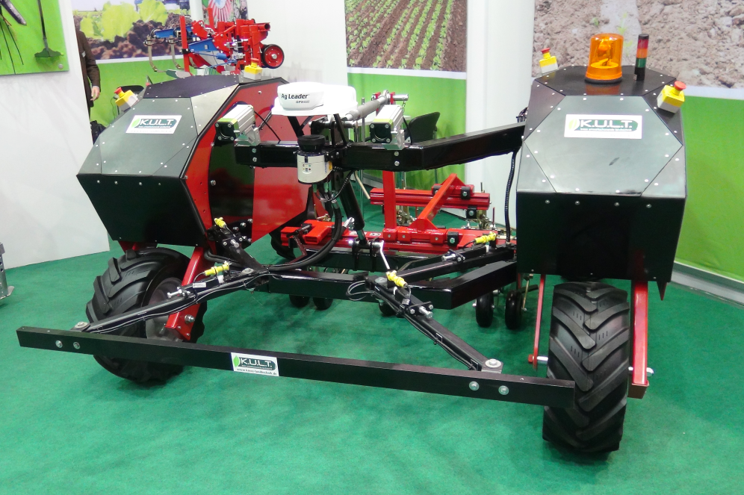
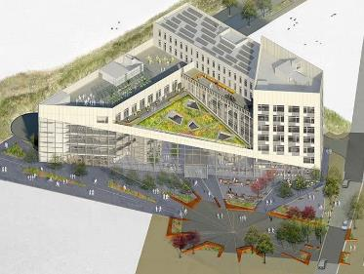
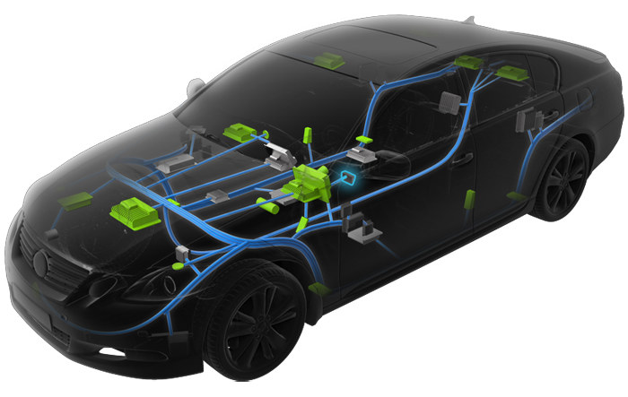
Our position in a nutshell
We advocate:
Cyber-Physical Systems Engineering
The product is a system: software is not the end!
Multidisciplinary collaborative modelling
(Co-) simulation as well as verification
Promotes Design Space Exploration
Entails well-founded co-simulation orchestration
Our approach:
Co-simulation of multiple Discrete Event and Continuous Time models
A tool chain – not single tools
Requirements and Architectural models (in SysML)
Traceability support through development
FMI interfaces constituent models
Semantic foundations in Unifying Theories of Programming

Slide 4
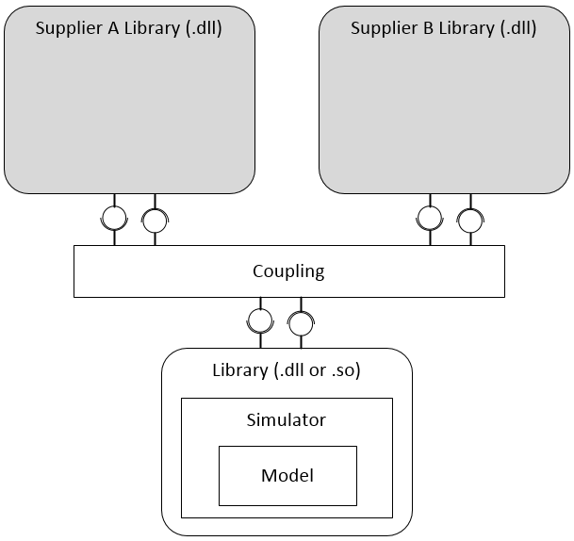
What is Co-simulation?
Simulation of a system
Coupling of multiple simulators
Optionally as black-boxes
Each simulating one or more models
Built with different formalisms/tools.
Co-simulation scenario
Description of the system
The simulators and their dependencies
Data about the capabilities of each simulator.

Slide 5
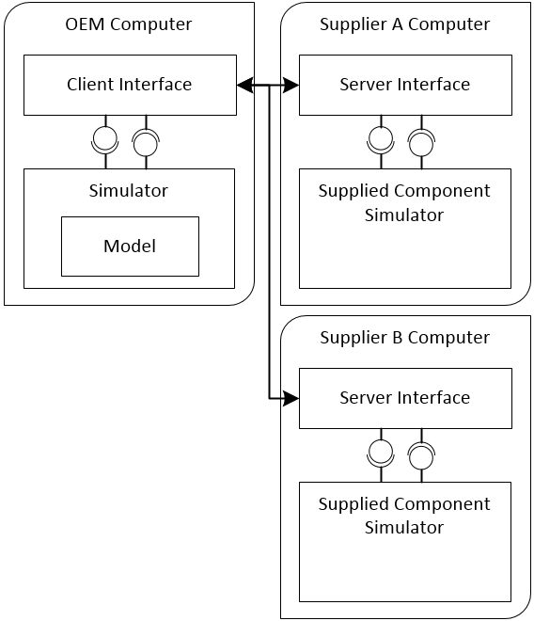
Remote Black-box Simulators
Suppliers make a simulator available through an API
Integrator takes care of programming an interface
Good IP Protection
Different suppliers require different interfaces

Slide 6
Functional Mock-up Interface Standard
Simulator and model exported as a standardized C library
Standard interaction with any simulator
Every simulator is a black box.
Executed locally but can communicate with a remote server

Slide 7
Inside an FMU
FMU
Real or Simulated
FMU
FMU
Model
Symbolic Info
Compiled
Model
Solver
Solver

Slide 8
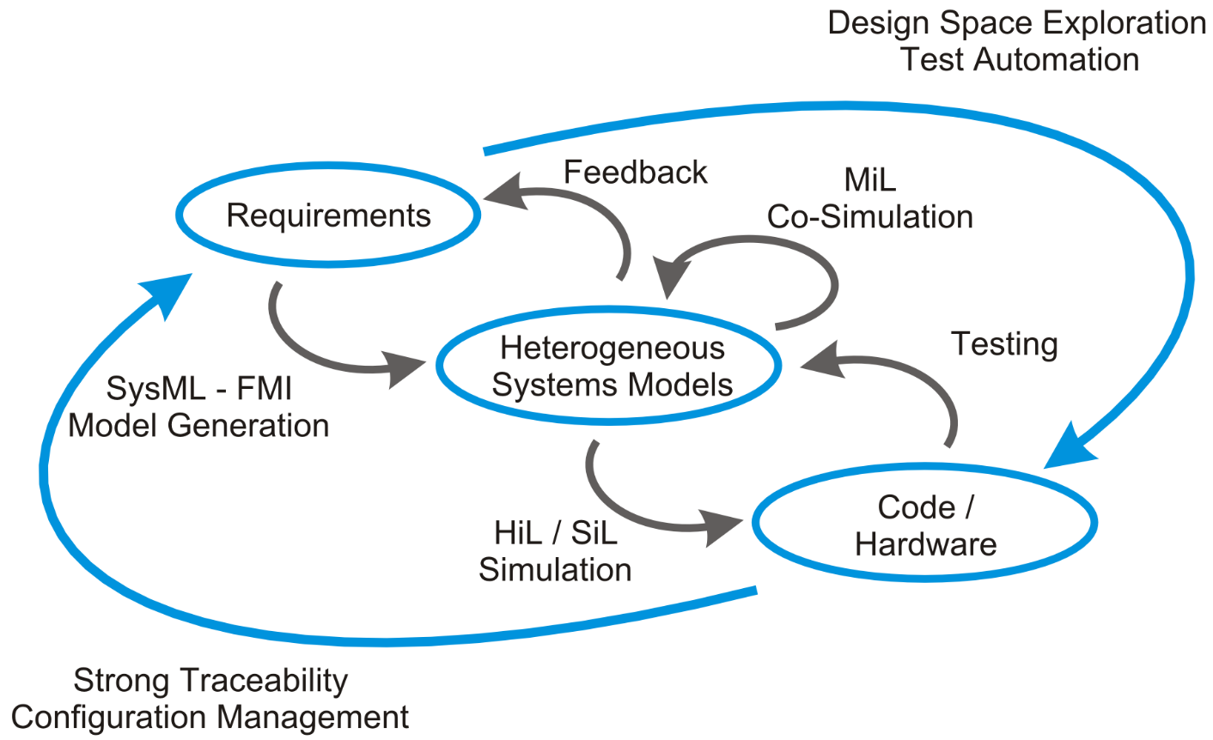
A New Toolchain for CPS Design

Slide 9
INTO-CPS Unique Selling Points
Faster route to market for engineering CPSs
Avoiding vendor lock-in by open tool chain
Exploring large design spaces efficiently
Limiting expensive physical tests
Enabling traceability for all project artefacts

Slide 10
CPS Engineering Needs
Enable collaboration across disciplines
Keep development costs low
Keep time-to-market short
Explore the complex design space efficiently
Ensure tolerance against “nasty” faults
Build up documentation for the working solution
Provide confidence to external stakeholders

Slide 11
Outline Work Flow
Requirements Engineering
Entry point 1
Construct SysML Architecture
Develop Simulation Models
Entry point 2
Create FMUs
Select Library FMUs
Connect Multi-model
Simulation (single / DSE)
Model Checking
Hardware/Software in the loop
Results

Slide 12

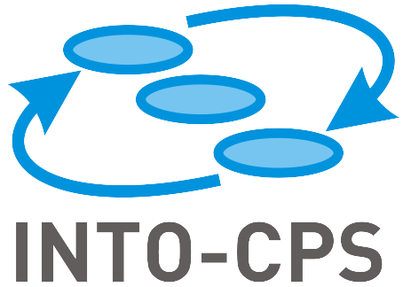

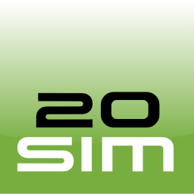


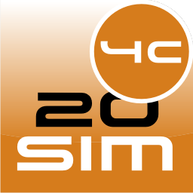
The INTO-CPS Tool Chain
Model Descriptions
exports
Modelio
imports
configures
Application
Overture
20-sim
OpenModelica
RT-Tester
code
export
oracle
Configure / launch
Co-simulation
Design Space Exploration
Model Checking
Test Automation
View Results
Traceability
configure
FMU
FMU
FMU
FMU
FMU
FMU
FMU
co-simulate
HiL
launch
COE (Co-simulation Orchestration Engine)
generates
20-sim 4C
gather
Result
Result
Result
Result
Traceability Daemon

Slide 13








Co-simulation engine
Fully FMI 2.0 compliant Master Algorithm
Support for discrete event (DE) and continuous time (CT) models, using proposed FMI extensions
Multi-platform, 32/64 bit (Java-based)
Application based on Electron (web-technology)
Fixed and variable step size algorithms
FMI 2.0 Import/Export created for Overture, OpenModelica, 20-sim
Has also been tested with:
Dymola
Modelon FMI Toolbox for MATLAB/Simulink
4DIAC
SimulationX
Unity

Slide 14
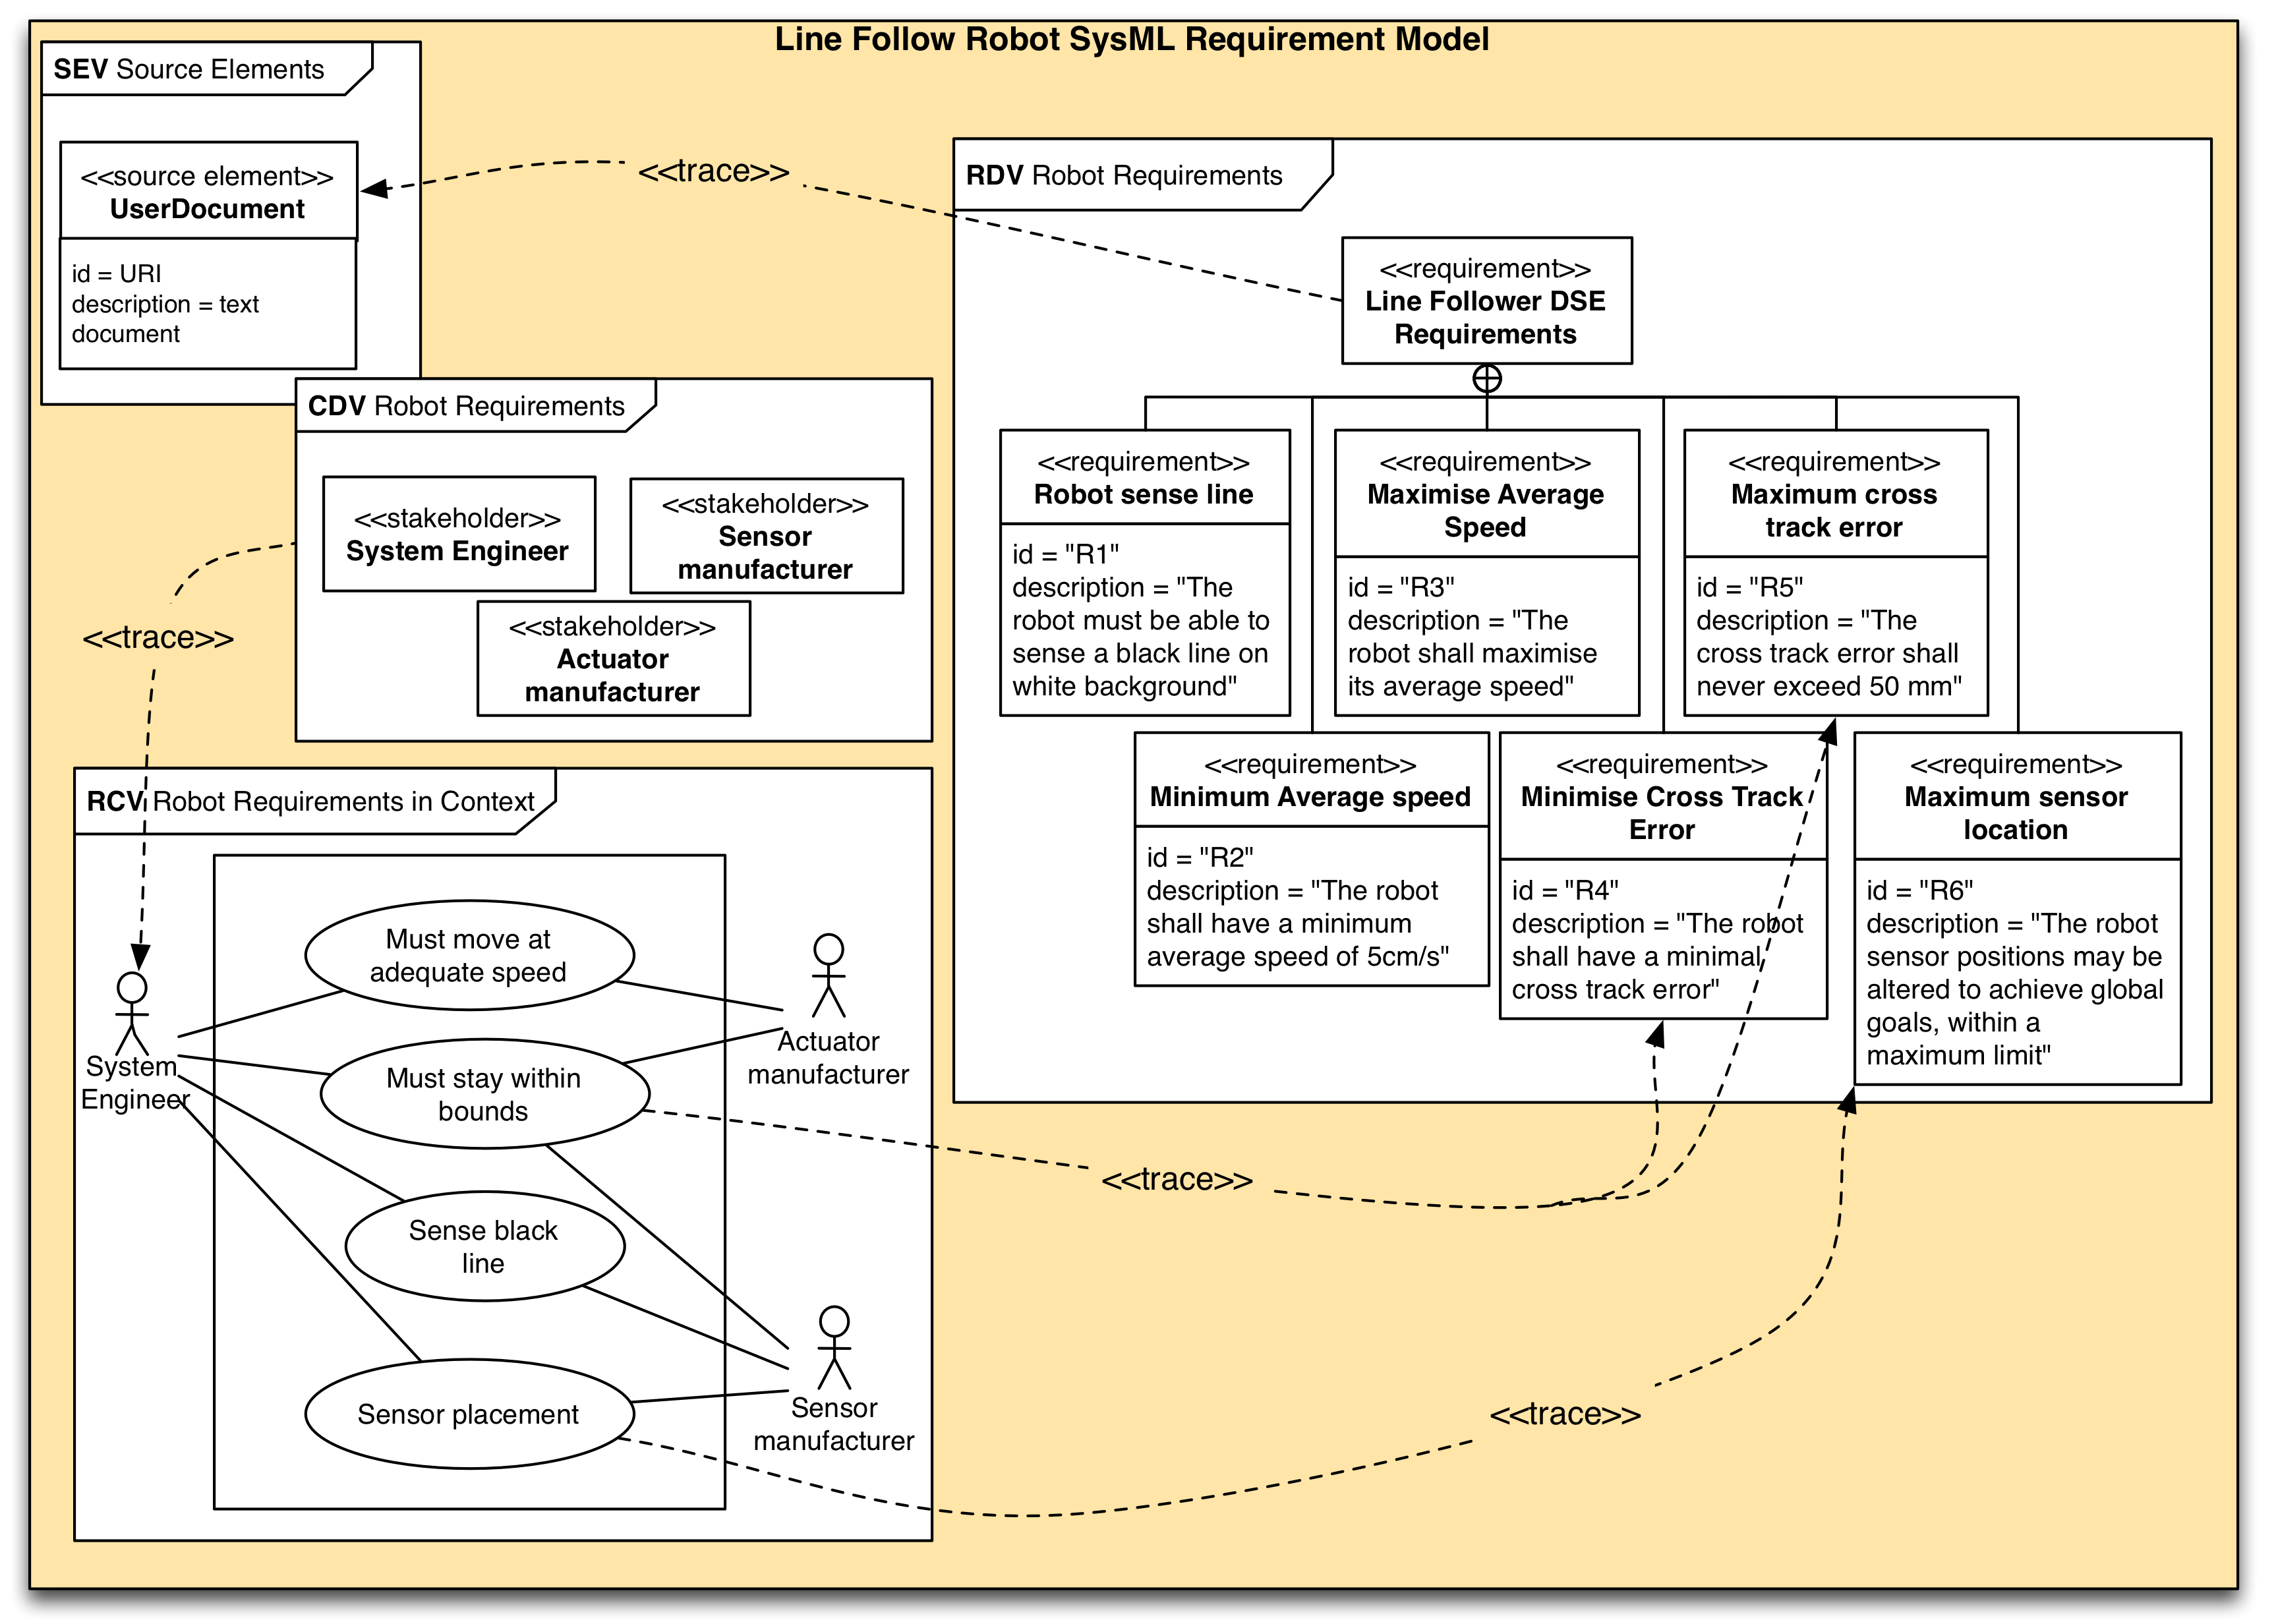
INTO-CPS Methodology
Requirement Engineering
Architectural Modelling
Simulation Modelling
Analysis

Slide 15
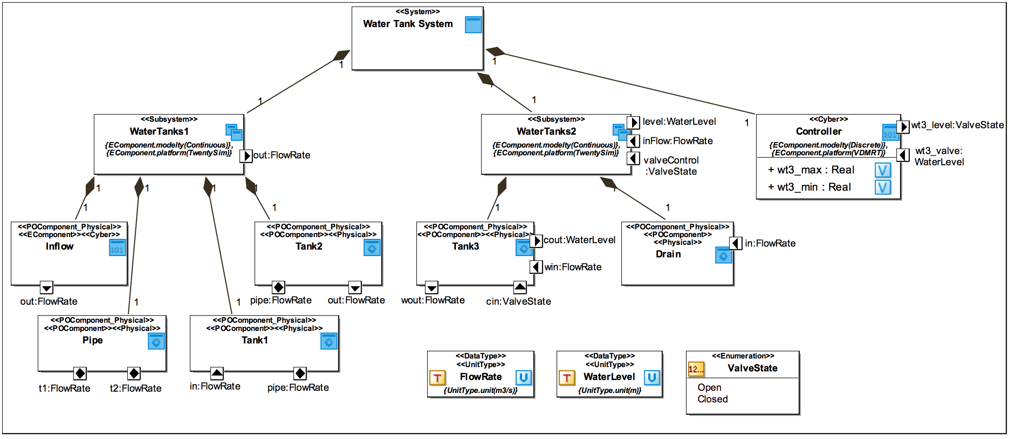
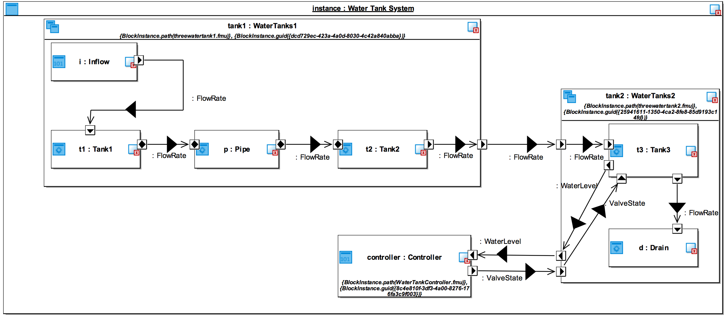
Architectural Modelling
Architecture Structure Diagram
Requirement Engineering
Architectural Modelling
Connections Diagram
Simulation Modelling
Analysis

Slide 16
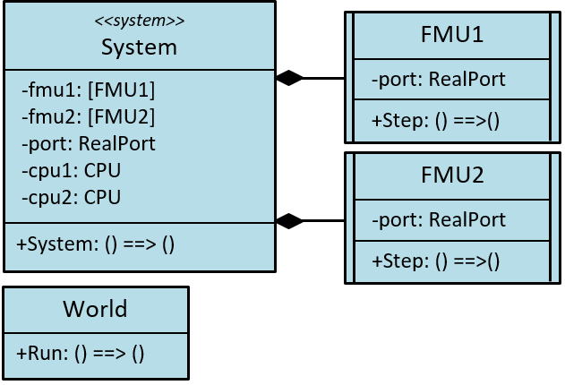
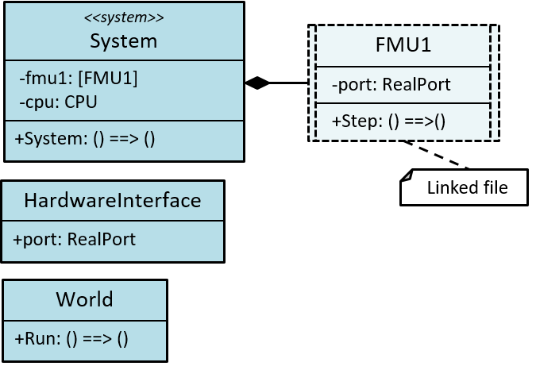
Simulation Modelling
“DE-first” approach, used in IPP4CPPS
Model and test entire system in DE
One class per EComponent, both DE and (abstract) CT
Use Ether pattern to connect classes if necessary
Move to multi-model
One project per EComponent (link class definition)
Export FMUs
Requirement Engineering
Architectural Modelling
Simulation Modelling
1.
2.
Analysis

Slide 17
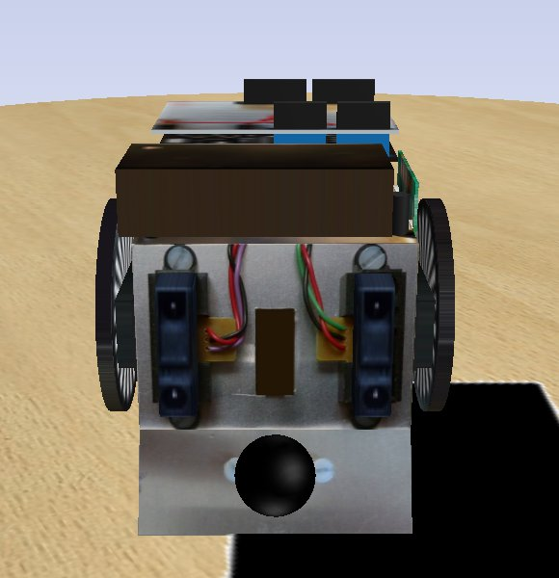
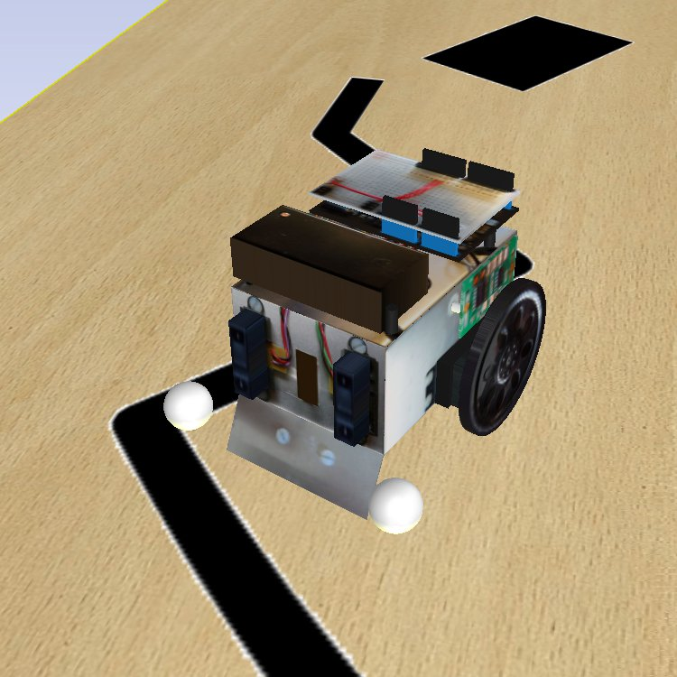
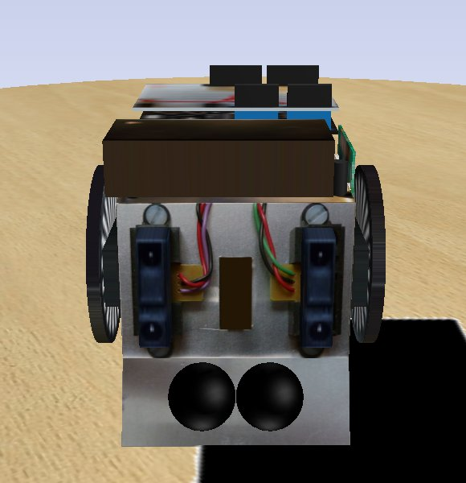
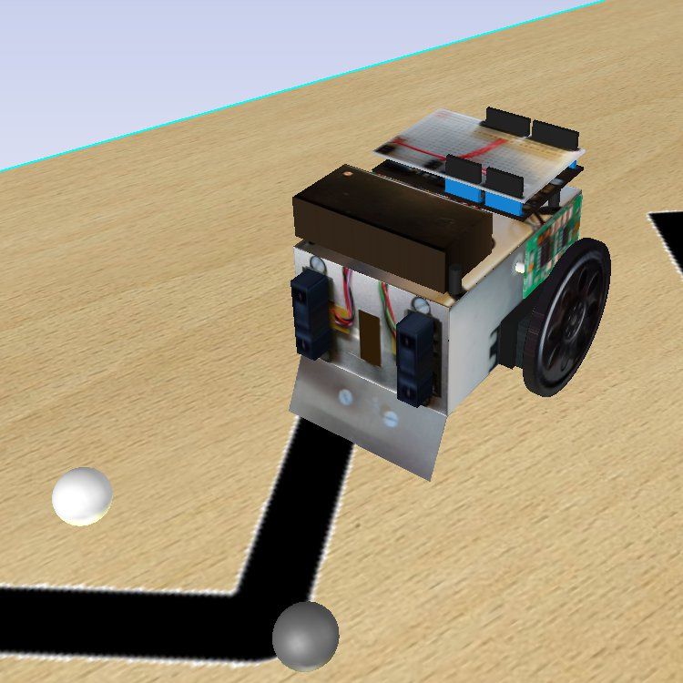
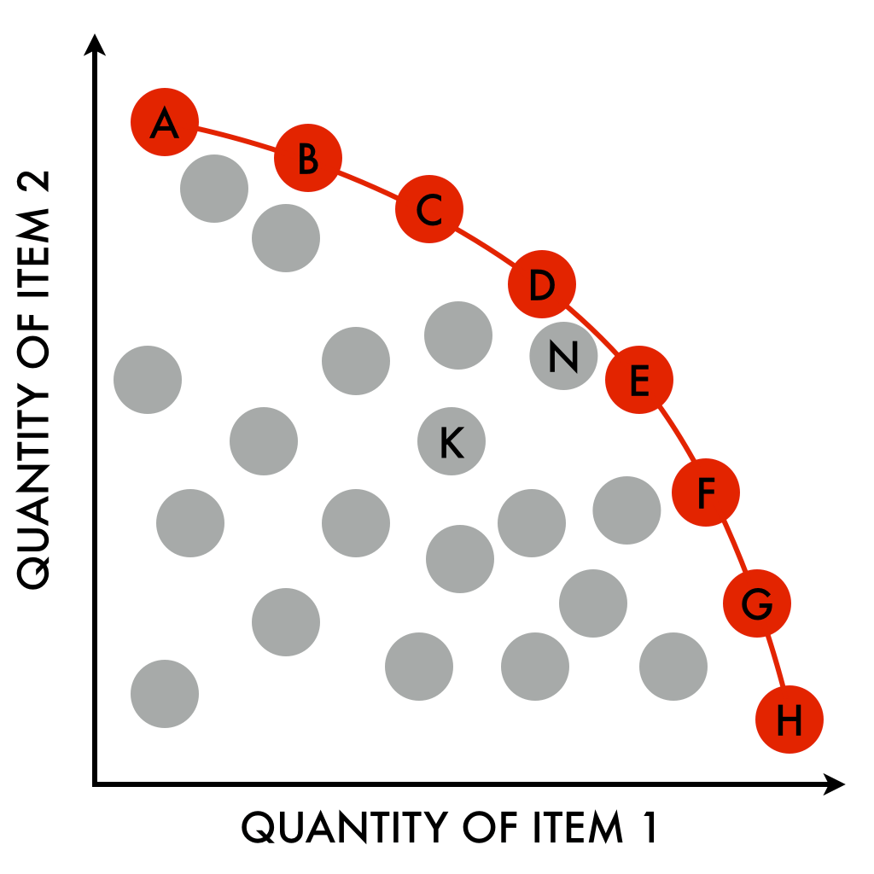
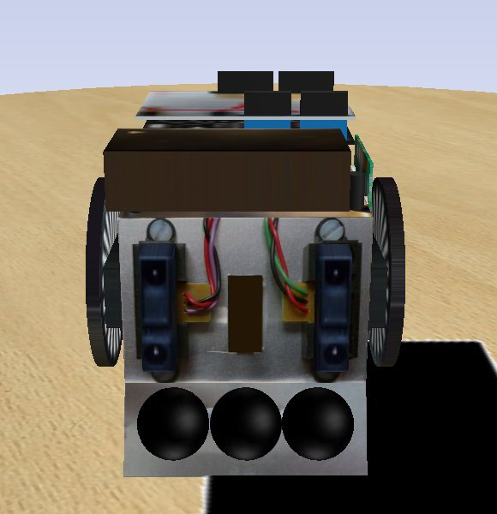
Design Space Exploration
Exhaustive
Taguchi Methods
Space Culling
Genetic Methods
How to Explore?
How to Assess?
DSE Driver
Objective Evaluator
Ranking
Presentation
Simulation parameters, control of process
Objective measures and constraint satisfaction from raw simulation results
Ranking designs according to objective values
Display of results and search progress to the user

Slide 18
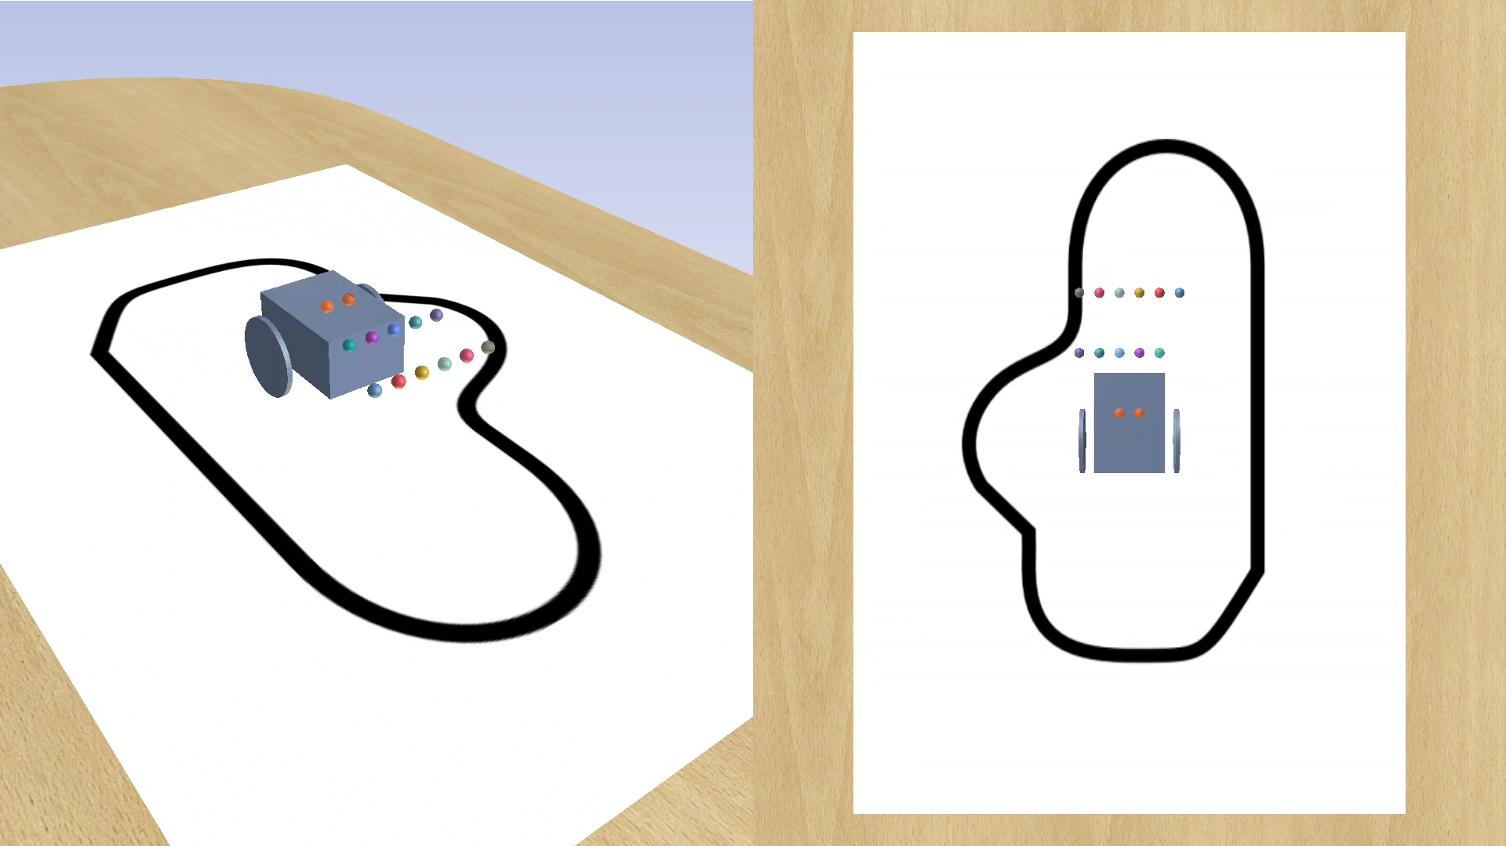
Example DSE Analysis
Requirement Engineering
Architectural Modelling
Simulation Modelling
Analysis

Slide 19
Co-Simulation Foundations
Initial foundations developed for
SysML
VDM-RT
Modelica
FMI
SysML CPS profile defined
Architecture Structure Diagram
Connections Diagram
Design Space Exploration Diagram
Support for units in the exported model descriptions

Slide 20
Common Semantics using UTP

Slide 21
Underlying Unified Semantics

Slide 22
INTO-CPS SysML CPS Profile
Three-tank Water Tank : INTO-CPS technology
Design architecture using INTO-CPS profile
Connections Diagram shows the connections between the different subsystems, and also their internal connections.
Architecture Structure Diagram comprised of three subsystems, corresponding to the three FMU models in the multi-model

Slide 23
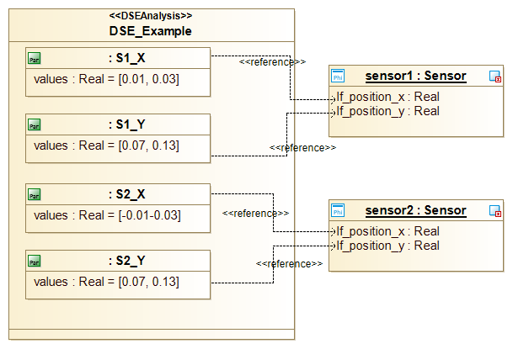
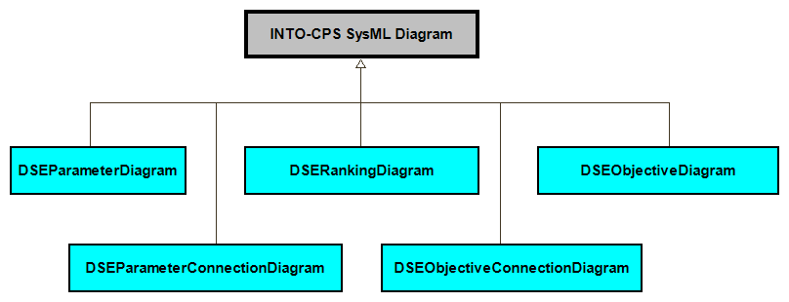
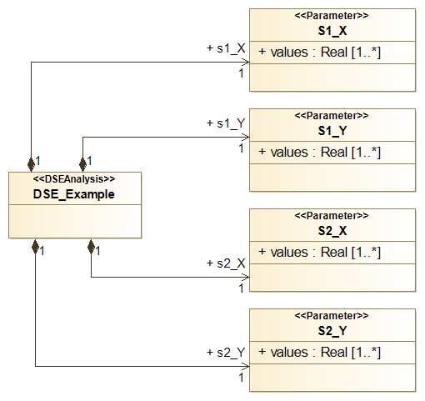
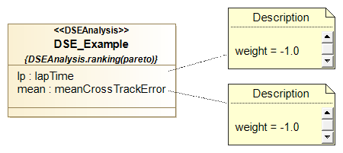
DSE Views in the SysML Profile

Slide 24
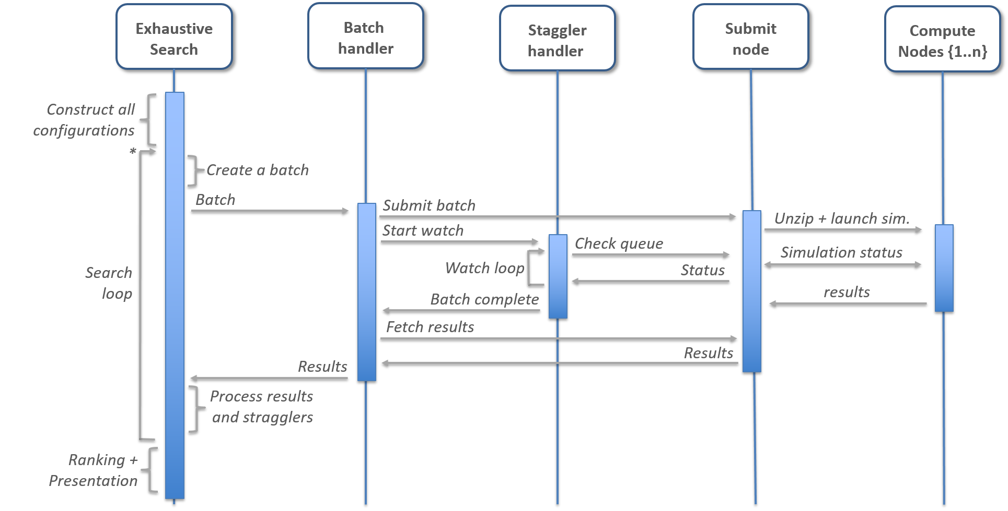
Cloud: Condor Exhaustive Search
Straggler handling:
return results when 80% of simulations complete or time > timeout

Slide 25
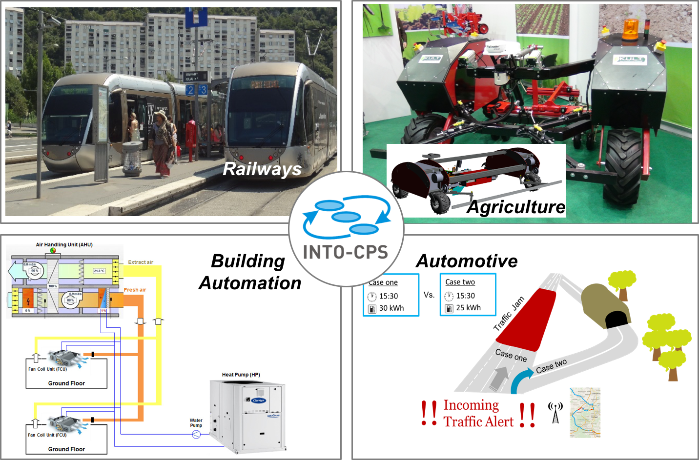
Industrial Case Studies

Slide 26
Industrial Follower Group
Denso Corporation, Japan
Dredging International, Belgium
DSTL, UK
EDF, France
Enginsoft, Italy
European Space Agency, Netherlands
Fortiss, Germany
Goodrich, UK
Grundfos, Denmark
GN Resound, Denmark
HADATAP, Poland
Holonix, Italy
HMF, Denmark
Huisman Equipment, Netherlands
IBM, Israel
IBM, Finland
Ikergune, Spain
Inestec, Portugal
Irmato, Netherlands
ISMB, Italy
Jaguar, UK
John Deere, Germany
JNE Systech, Korea
MAN Diesel & Turbo, Denmark
MFAtech, UK
NII, Japan
Nupark Accelerace, Denmark
Odego, Germany
OFFIS, Germany
Omflow, UK
ONERA, France
Oticon, Denmark
Phillips MRI, Netherlands
PLM Consult, Denmark
Polar Electro, Switzerland
Postech, South Korea
Prime Solutions Group, USA
Projectglobe.com, UK
Rockwell-Collins, France
Rolls-Royce, UK
Saab, Sweden
Santer Reply, Italy
Seluxit, Denmark
Siemens, Sweden
Synelixis Solutions,Greece
Syntell, Sweden
TailSiT, Austria
Tecnalia, Spain
Terma, Denmark
Thalès R&T, Germany
TTTech, Austria
thyssenkrupp Marine Systems, Germany
UTC Aerospace, UK
Vesta System, France
West Consulting, Netherlands
In total: 80
AGCO, Denmark
Airbus, UK
Alcatel Lucent, Ireland
Almende, Netherlands
Alten, Sweden
Altran, UK
Andritz Hydro, Austria
Bachmann Electronic, Netherlands
Bakker-Sliedrecht, Netherlands
Bang&Olufsen, Denmark
Beia Consult, Romania
Beumer, Denmark
Bombardier, Germany
Bosch, Germany
Carrier, France
CCFE, UK
CeTIM, Netherlands
Chemring Technology, UK
Conpleks Innovation, Denmark
Continental, Romania
Critical Software, Portugal
Daimler, Germany
Danish Aviation, Denmark
Dassault Aviation, France
Delphi, Poland

Slide 27
The INTO-CPS Association Created
Purposes
Maintain and develop further software that was created in the project
Enable the widespread use of the software through open source licenses
Promote its usage in academic and industrial settings
Allow members to steer direction of development and incorporate software into products

Slide 28
INTO-CPS Association - Technologies
SysML profile
Abstract modelling of CPS
Builds on top of the Modelio tool (Open Source)
Export of configurations for multi-models and DSE
Traceability support
Co-Simulation Orchestration engine
FMI 2.0 compliant master algorithm
Supports Windows, Linux, Mac
Parallelization and distribution support
Design Space Exploration tools
Algorithms for defining DSE runs and ranking the results
Uses DSE configurations from Modelio
Integrates well with the INTO-CPS application
INTO-CPS application
User Interface for setting up and executing Co-Simulation runs
Integrates many elements of the INTO-CPS tool chain
INTO-CPS Traceability deamon
Using OSLC to track updates from all tools
3D Animation FMU
Unity support for FMU 3D animation

Slide 29
INTO-CPS Association - Licencing
General public | View source-code Use software for non-commercial purpose
Associated members | In addition: use software for commercial purpose
Silver members | In addition: voting rights at General Assembly
Gold members | In addition: combine software with own software for commercial purpose, without the need to publish the code when

Slide 30

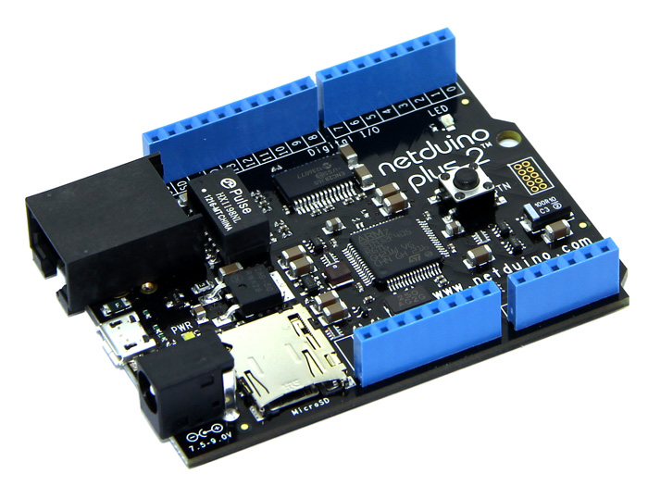
Hardware-in-the-Loop (HiL) and Code Generation
DE Model
DE Model
CT Model
CT Model
Functional Mock-up Interface
Code Gen.
Code Gen.
Multi-model
HiL

Slide 31
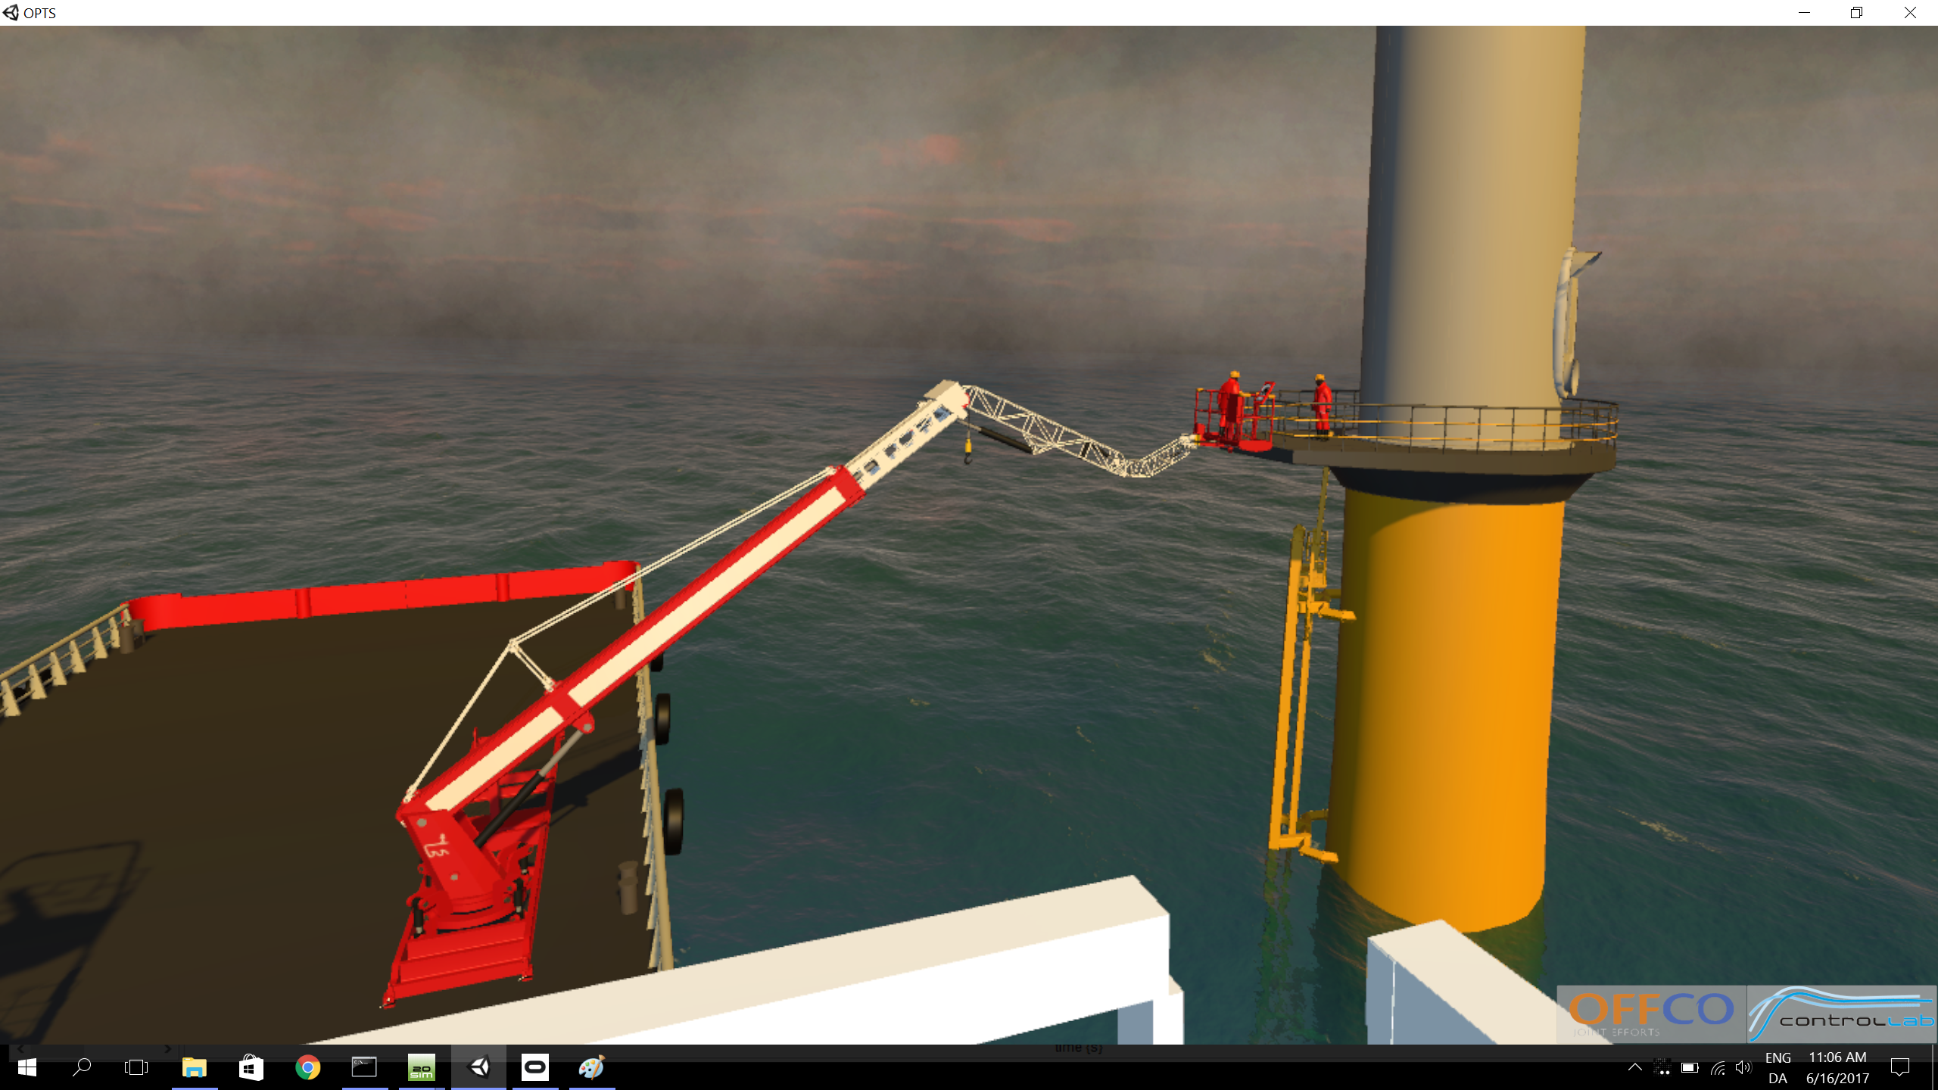
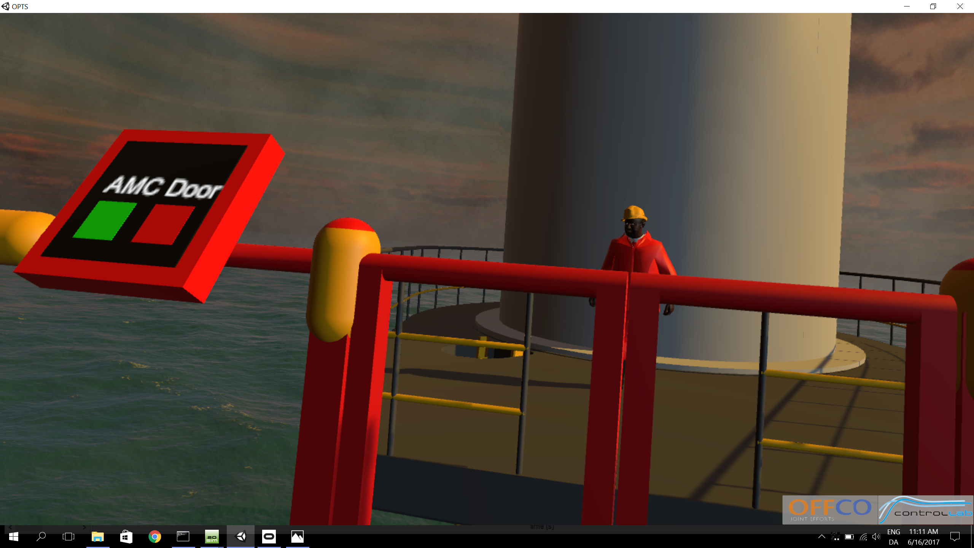
Oculus Rift and Simulation

Slide 32

Seeing a Product before it exists

Slide 33
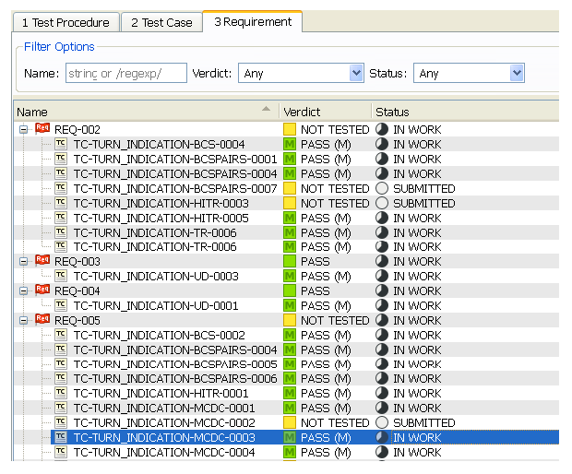
Test Automation
Based on RT Tester tool suite
Status:
Test sets generated from XMI import (from Modelio)
Test procedures are generated as FMUs, connected to Co-simulation
Outlook:
Identify SuT in SysML profile, connect to Test Automation
Connect SysML requirements with LTL formulas

Slide 34
Model Checking Capabilities
Now finding shorter counter examples.
Integration of traceability.
Provides abstractions for CT signals:
Interval-based abstraction
Simulation-based abstraction (new)
Gradient-based abstraction (new)

Slide 35
Simulation-based abstraction
During model checking a CT variable should behave similar to a previous concrete execution of the entire system.
Extract signal flow from a test-run.
Signal flow is abstracted by a succession of interval abstractions.
Specify max allowed size of intervals to adjust granularity.

Slide 36
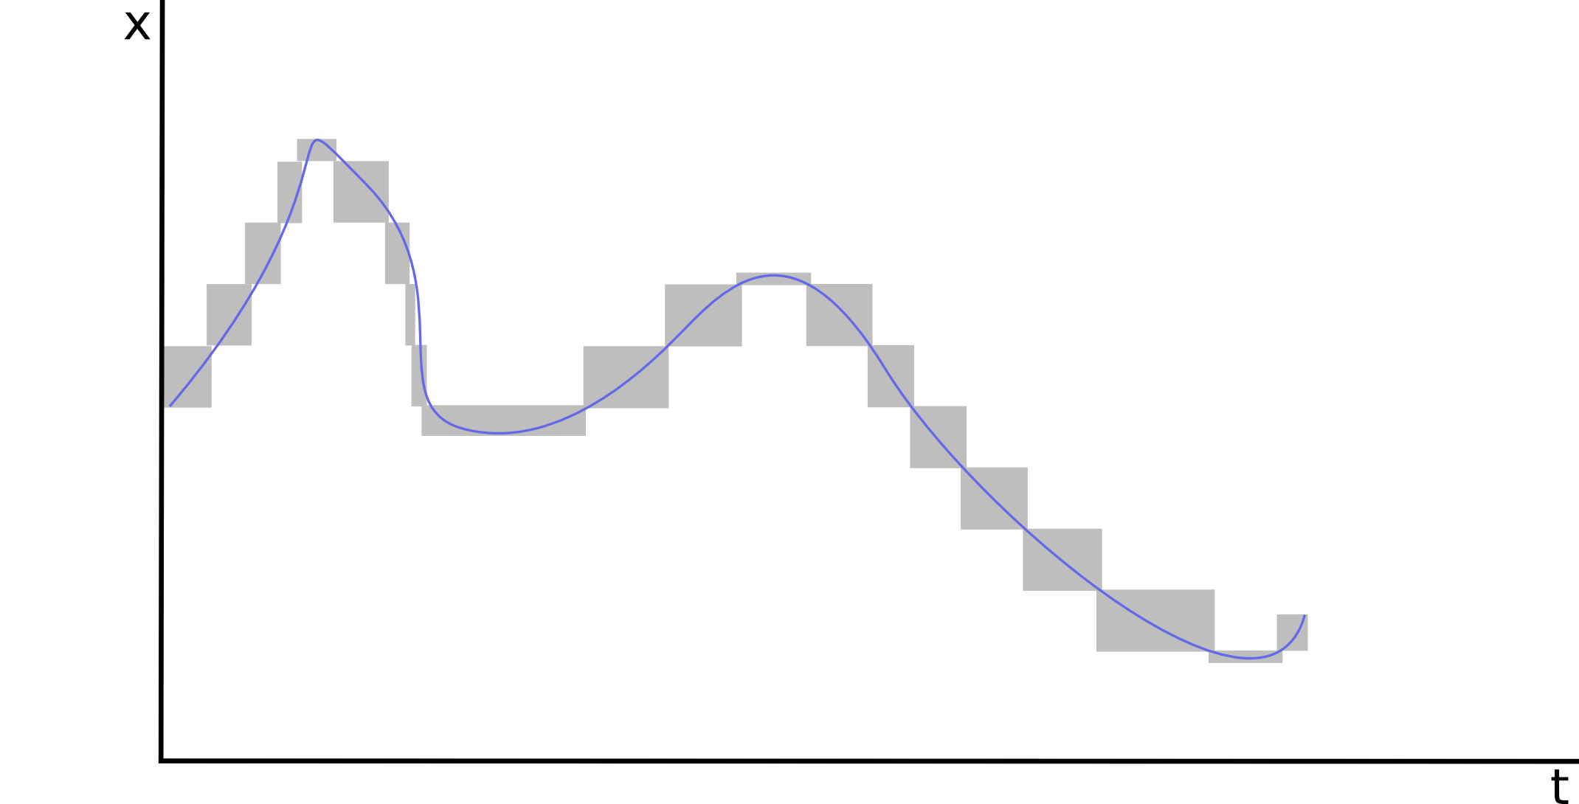
Abstraction by Interval Boxes

Slide 37
Gradient-based Abstraction
Allow CT variable to increase/decrease only up to a certain amount per time.
Implemented by a simple DE state machine.
t.elapsed(10)
s0
entry:
v = random(0, 20)
s1
entry:
v += random(0, 5)

Slide 38
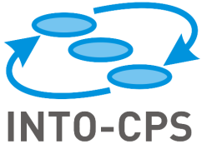





Traceability & Provenance
Goal: Ensure tracing between requirements, models, results, code
Keep track of changes
Use OSLC / Prov-N standards
Modeling / Simulation tool
Application
Traceability manager
COE
Traceability plug-in
Repository / Database

Slide 39

Traceabilty – tool support
Requirements creation / linking with SysML blocks
Architecture modelling
ModelDescription.xml export
Configuration export
Modelio
OpenModelica
Overture
20sim
RT Tester
INTO-CPS App
ModelDescription.xml import
Model creation / modification
FMU export
Define test model
Define test objectives
Run test
Define MC model
Define CT abstraction
Run MC query
Configuration to Multi-Model
Multi-model to COE configuration
Simulation

Slide 40
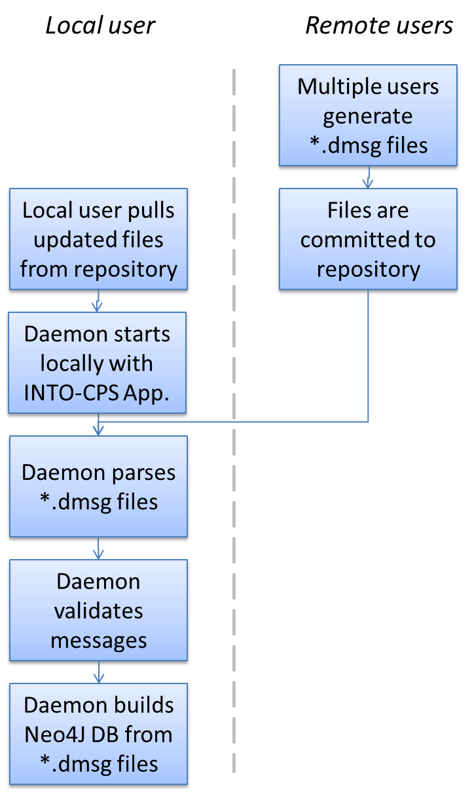
Traceability – multi-user support
Each message is a single plain text file (*.dmsg)
Messages are committed to common repository
Each user can generate messages

Slide 41
Solutions for CPS Engineering Needs
Enable collaboration across disciplines
Collaborative well-founded tool chain
Keep development costs low
Lower need for physical tests by virtual co-simulation examination
Keep time-to-market short
Enable concurrent engineering and gradual integration
Explore the complex design space efficiently
Using Design Space Exploration
Ensure tolerance against “nasty” faults
Experiment with what-if scenarios in a virtual setting
Build up documentation for the working solution
Using combination of ad-hoc and automated tests
Provide confidence to external stakeholders
Traceability between all project artefacts

